Slide 1
Travel Insurance Analysis

Slide 2
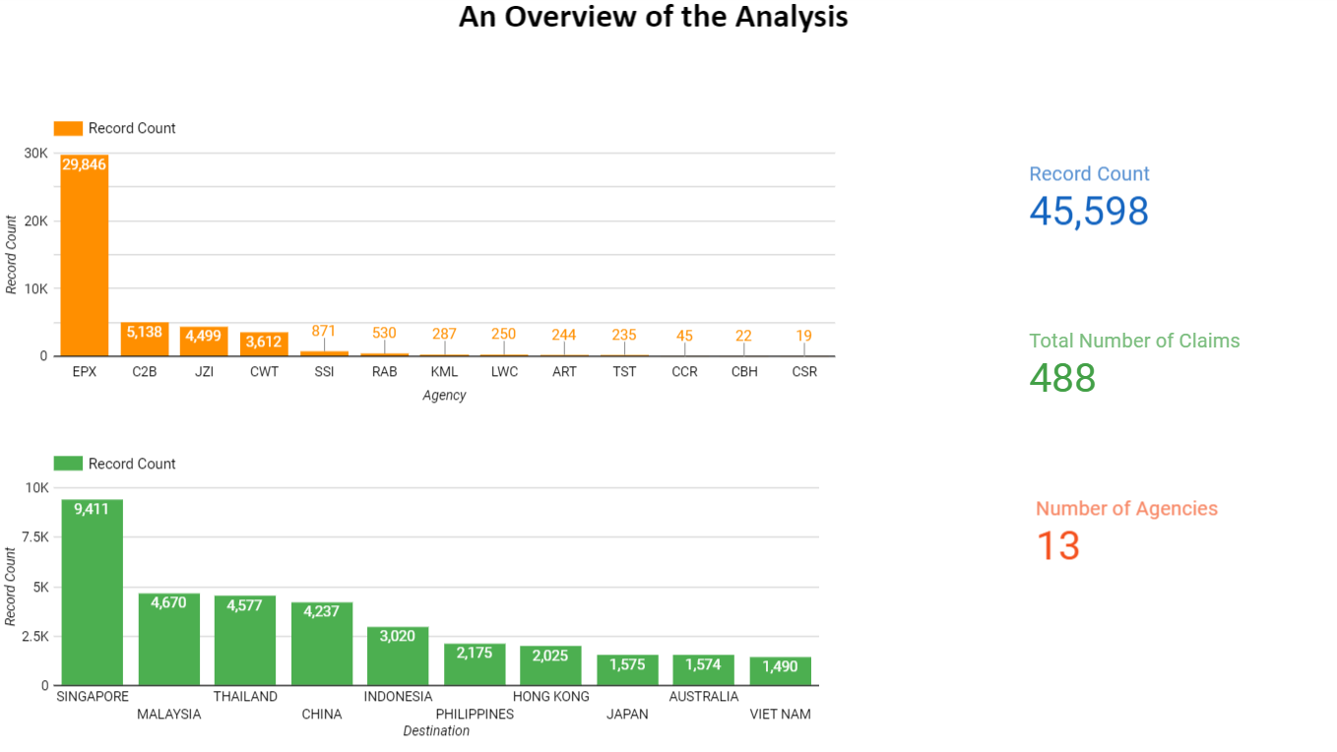

Slide 3
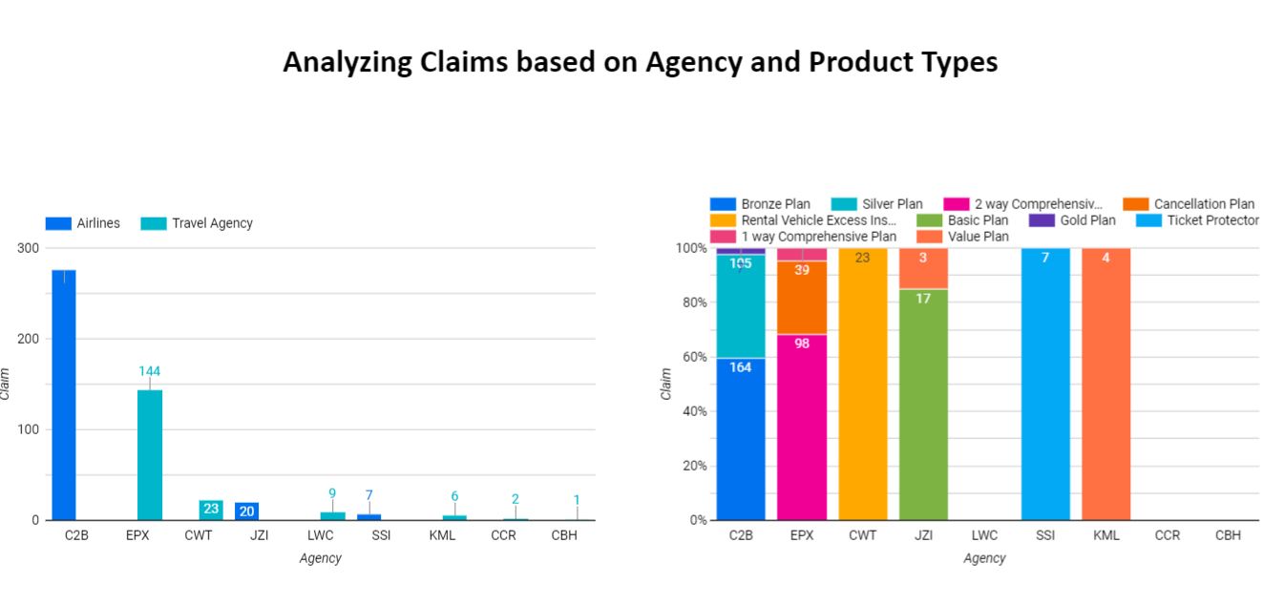
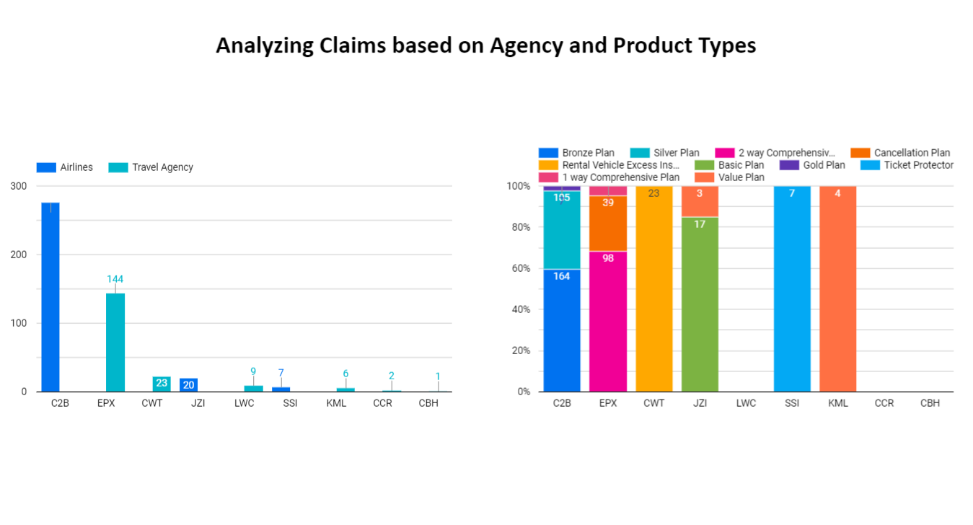

Slide 4
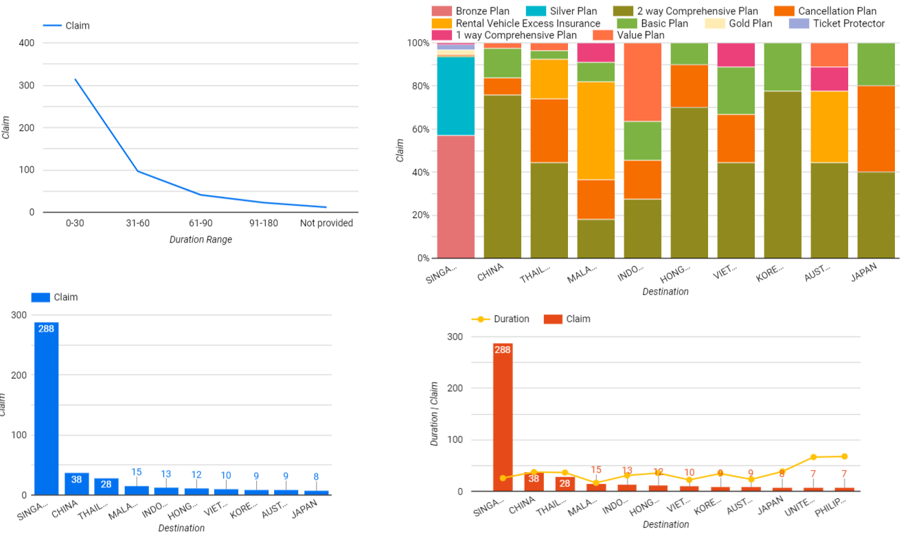
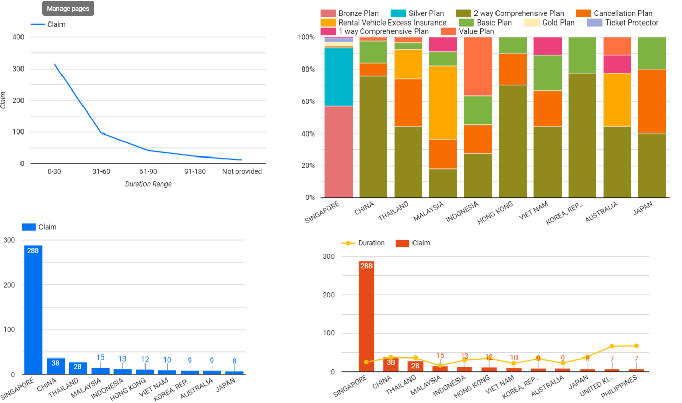
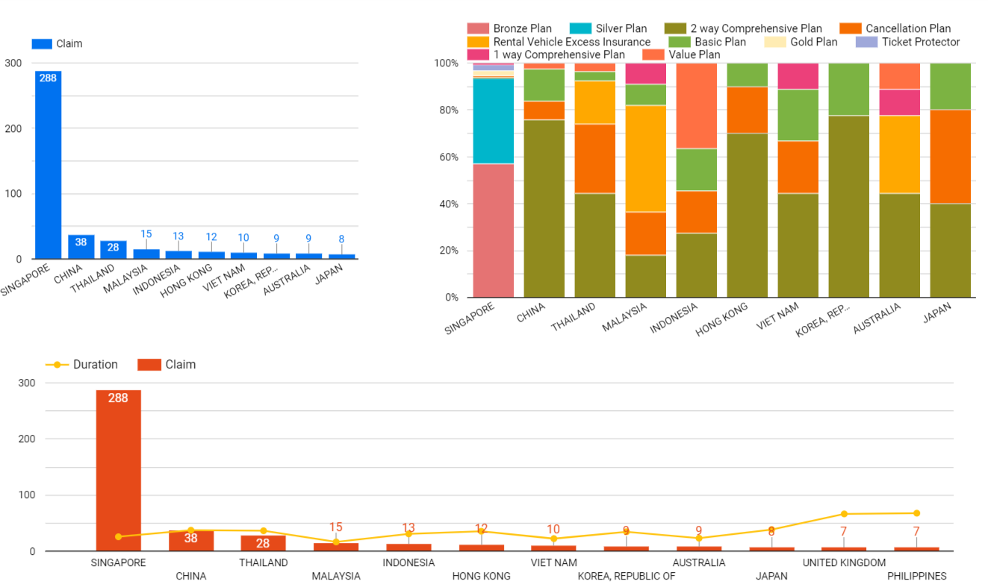
Analyzing Claims based on Customers Travel Path and Insurance Plan

Slide 5
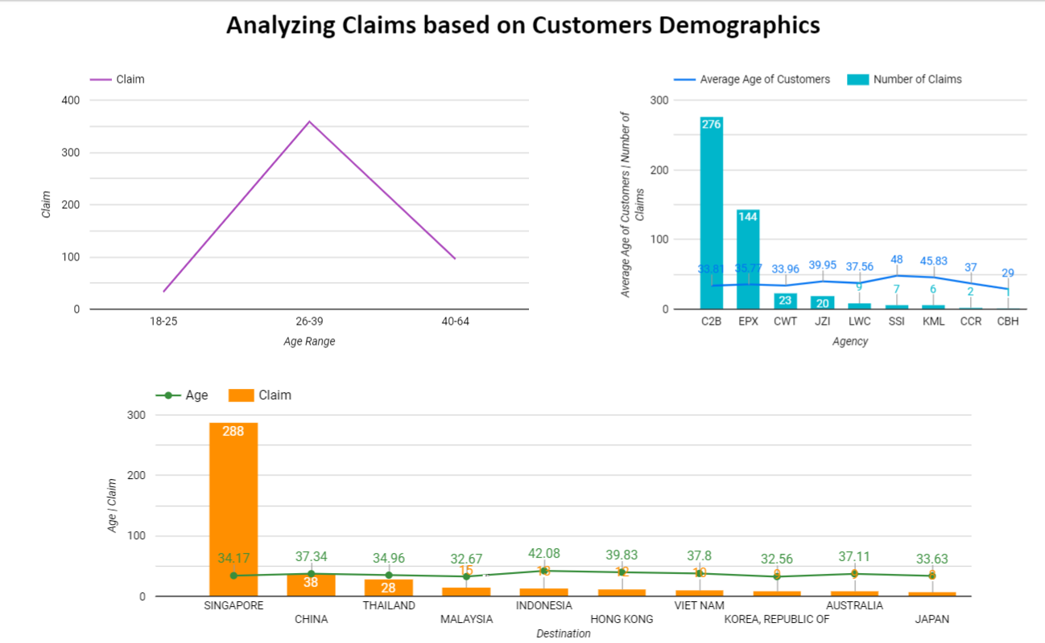

Slide 6
Conclusion
3% of Customers travelling to Singapore claims their travelling Insurance.
Customers in the age range of 26-39 has a high risk of claiming insurance.
Customers travelling for less than 30 days has the highest number of insurance claims.

Slide 7
Resources
Data Studio Dashboard URL
https://datastudio.google.com/reporting/6db09103-ac1b-41c8-bd51-efd1cbc75a71

